Slide 1


WAREHOUSE MANGEMENT SYSTEM
RNS INSTITUTE OF TECHNOLOGY
BENGALURU - 98
DEPARTMENT OF INFORMATION SCIENCE & ENGINEERING
DBMS MINI PROJECT SEMINAR
BY
V BHARATH
1RN17IS110
T MALLIKARJUN NAYAK
1RN17IS04
Under the guidance of
FACULTY INCHARGE LAB INCHARGE
Ms.Soumya SK Mrs. Kusuma S
Assistant Professor, Assistant Professor,
Department of ISE, RNSIT

Slide 2
AGENDA
Abstract
Introduction
Requirements
ER-Diagram
Schema Diagram
Tables description
Results
Snapshots
Applications
Conclusion
References

Slide 3
ABSTRACT

Slide 4
INTRODUCTION
This project is aimed at developing a web application for Warehouse management. The system is a web application that can be accessed throughout the organization with proper login provided. This system can be used as a web application for real time tracking and inventory management. Employees can login and see the status and respective delivery dates with time. Our project provides the facility of maintaining the details of the employees. It also provides a requested list of items present in the warehouse based on given query. Administrator logging in may also search any information put up by the employees. This project will aid in faster and efficient use of inventory space.

Slide 5
REQUIREMENTS
Hardware:
Processor: Intel dual core and above
Ram: 2GB
Operating System: Windows 7, Windows 8, Windows 10
Internet Connection: Existing telephone lines, Data card or Any Wireless Network
Browser: Google chrome latest version, Internet Explorer 10
Software:
HTML
CSS
Javascript
MySQL (Database)
PHP (Backend)

Slide 6
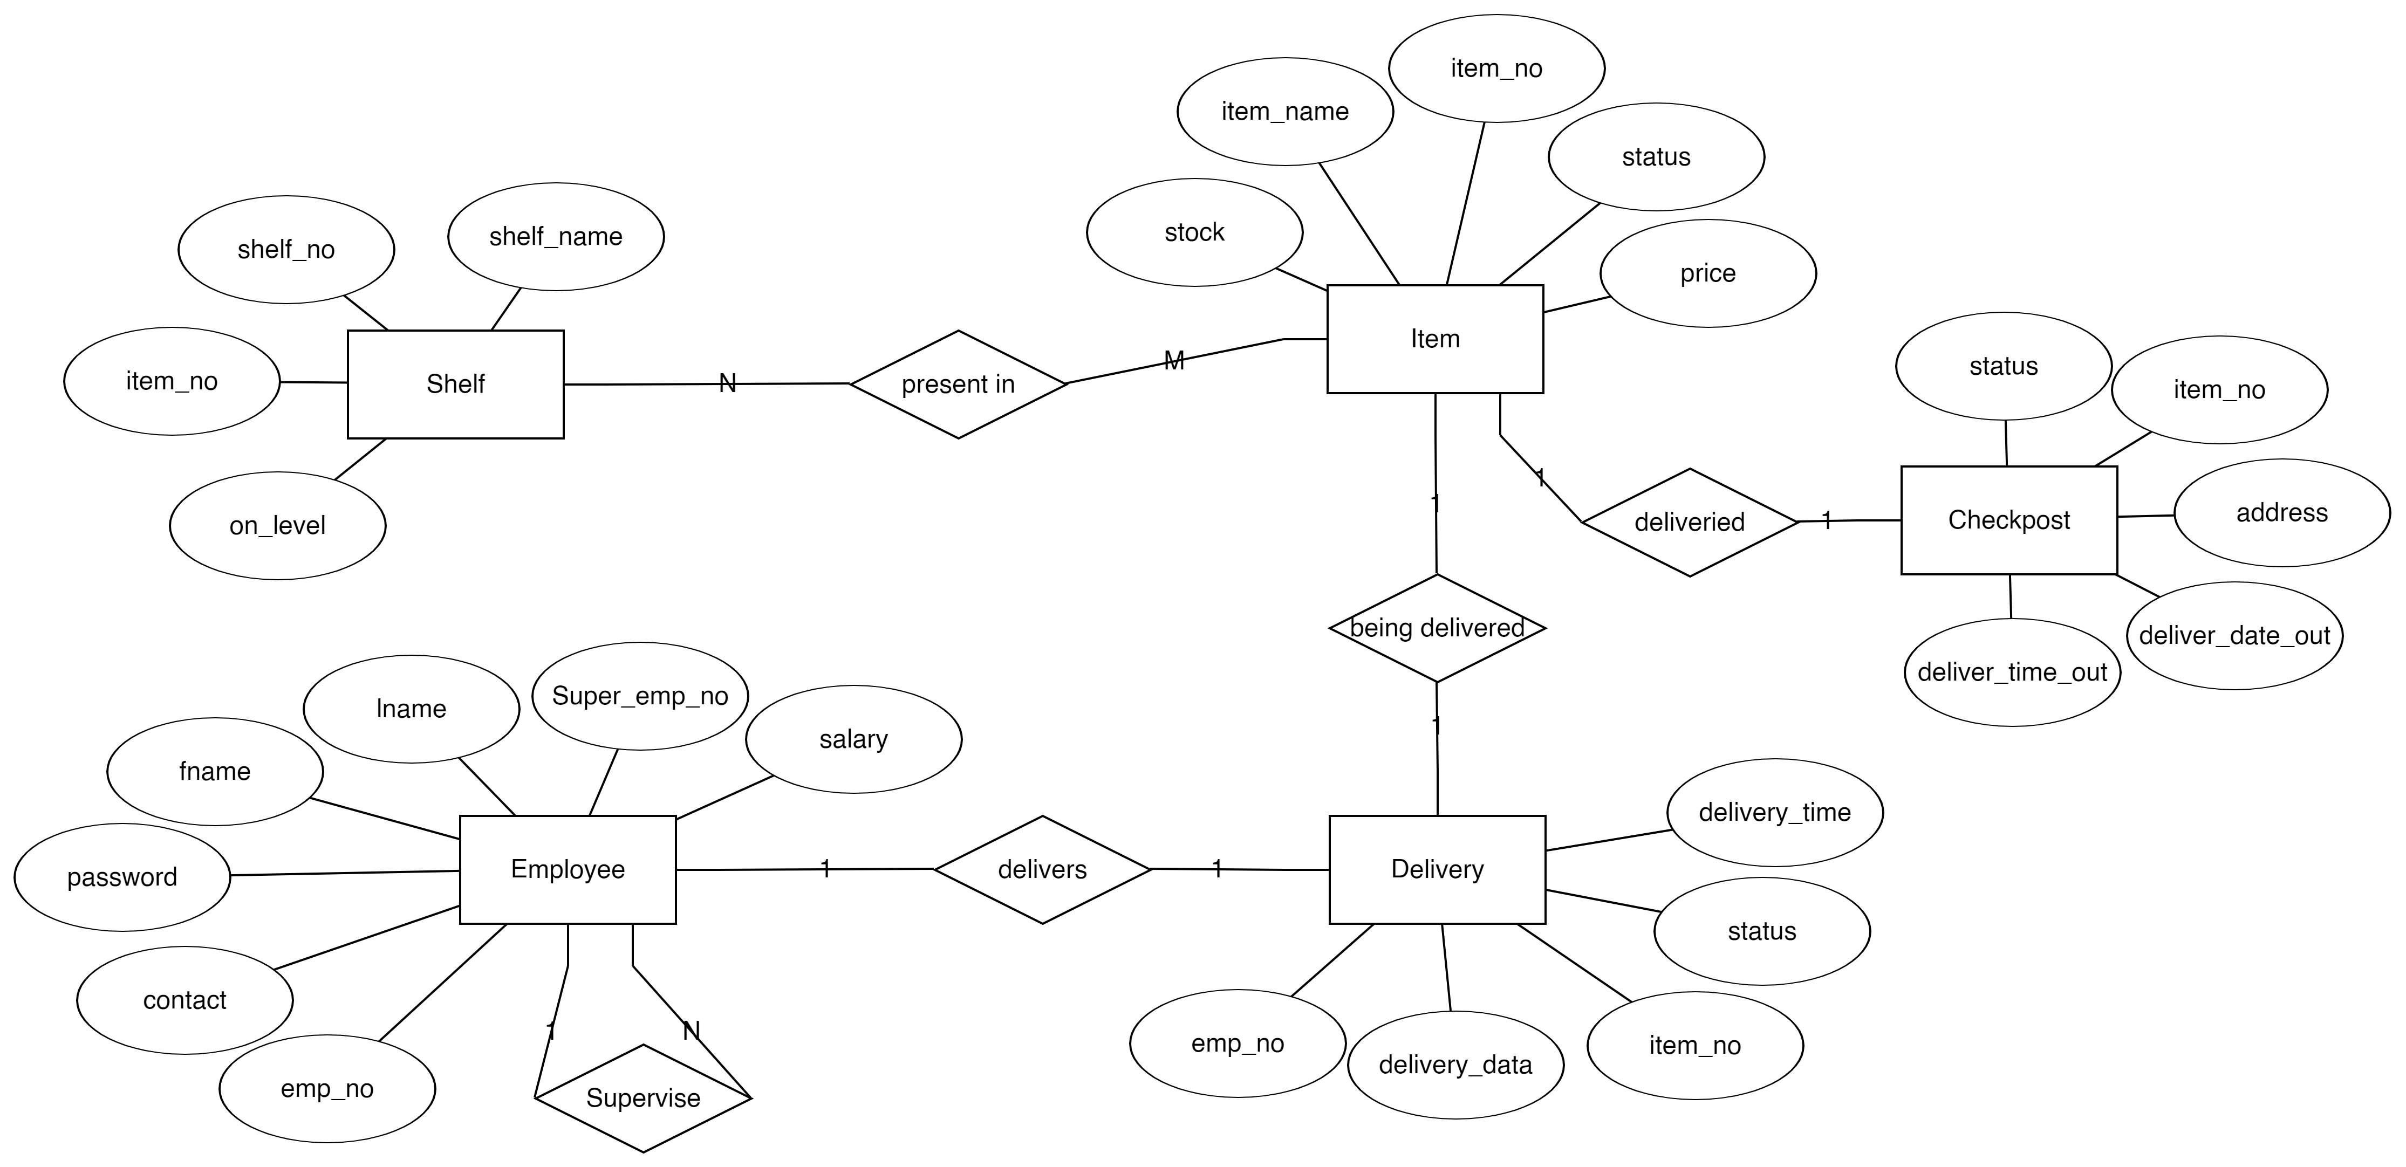
ER DIAGRAM

Slide 7
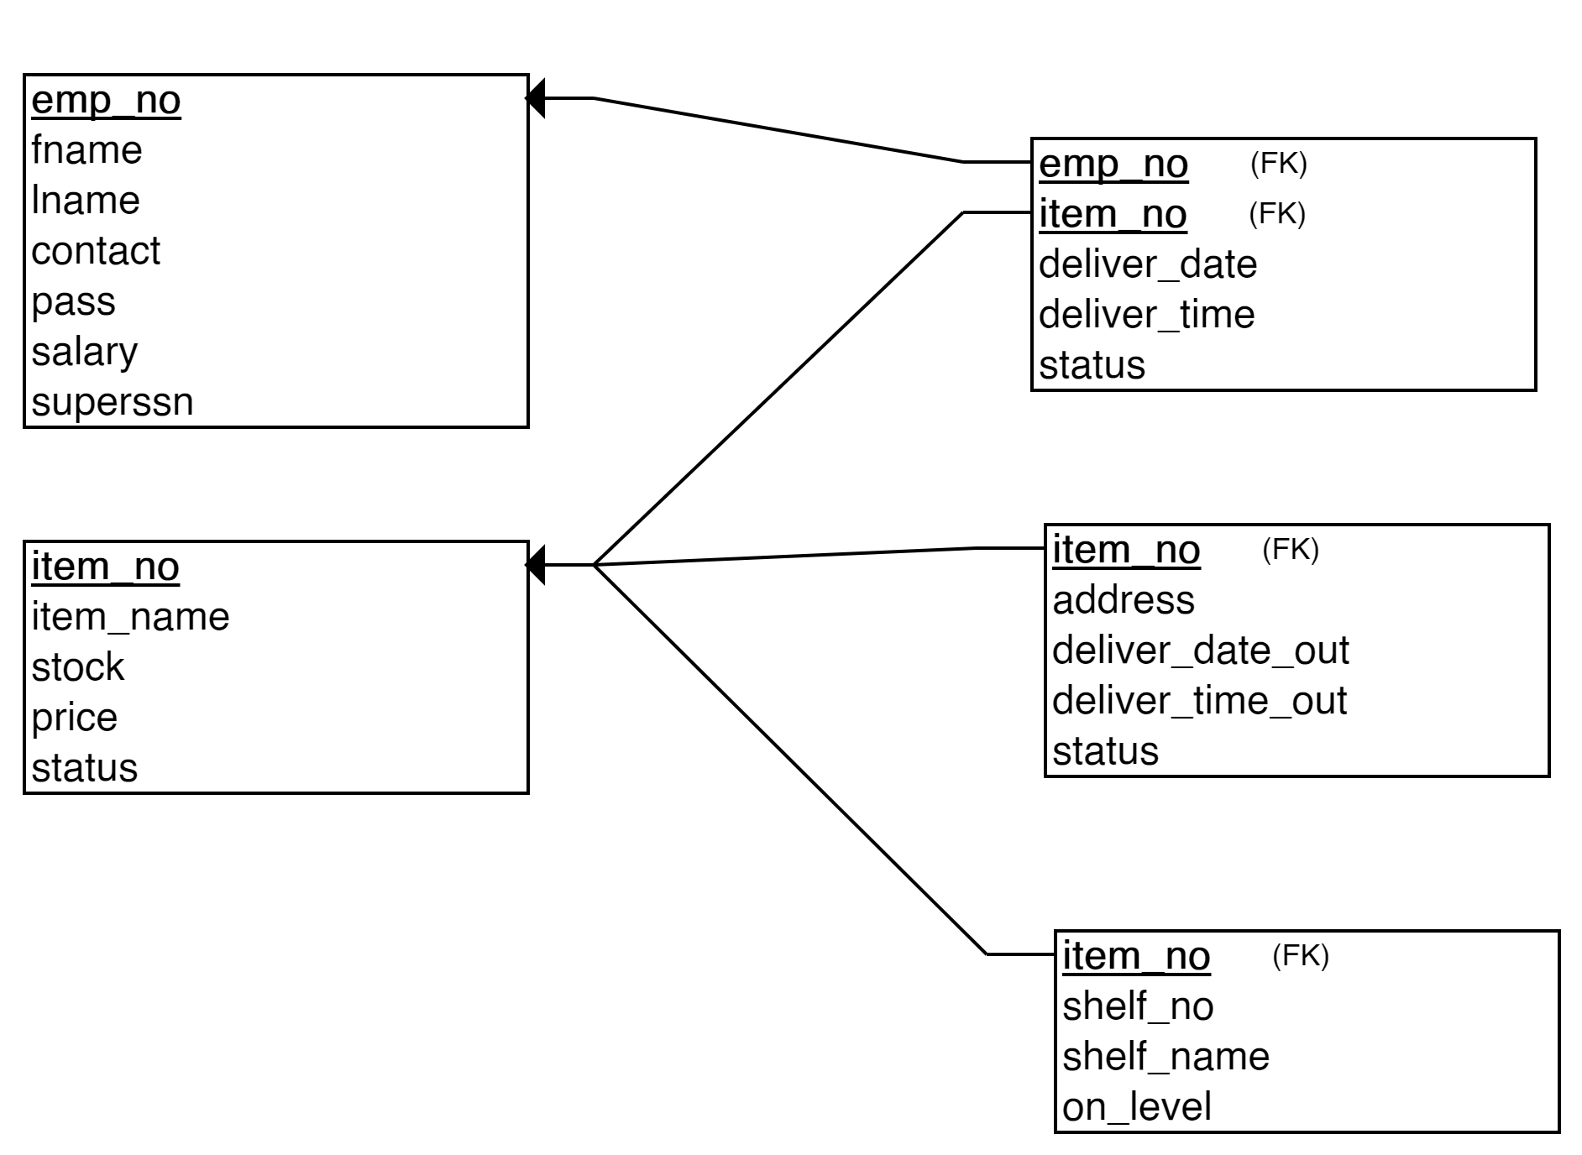
SCHEMA DIAGRAM

Slide 8
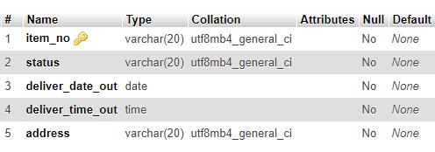
TABLES DESCRIPTION
TABLE CHECKPOST

Slide 9
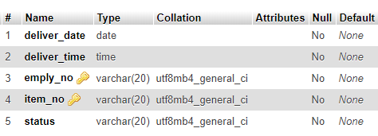
TABLE DELIVER

Slide 10
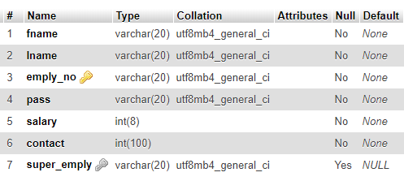
TABLE EMPLOYEE

Slide 11
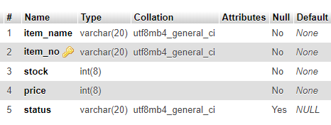
TABLE ITEM

Slide 12
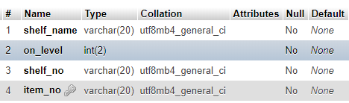
TABLE SHELF

Slide 13
RESULTS

Slide 14
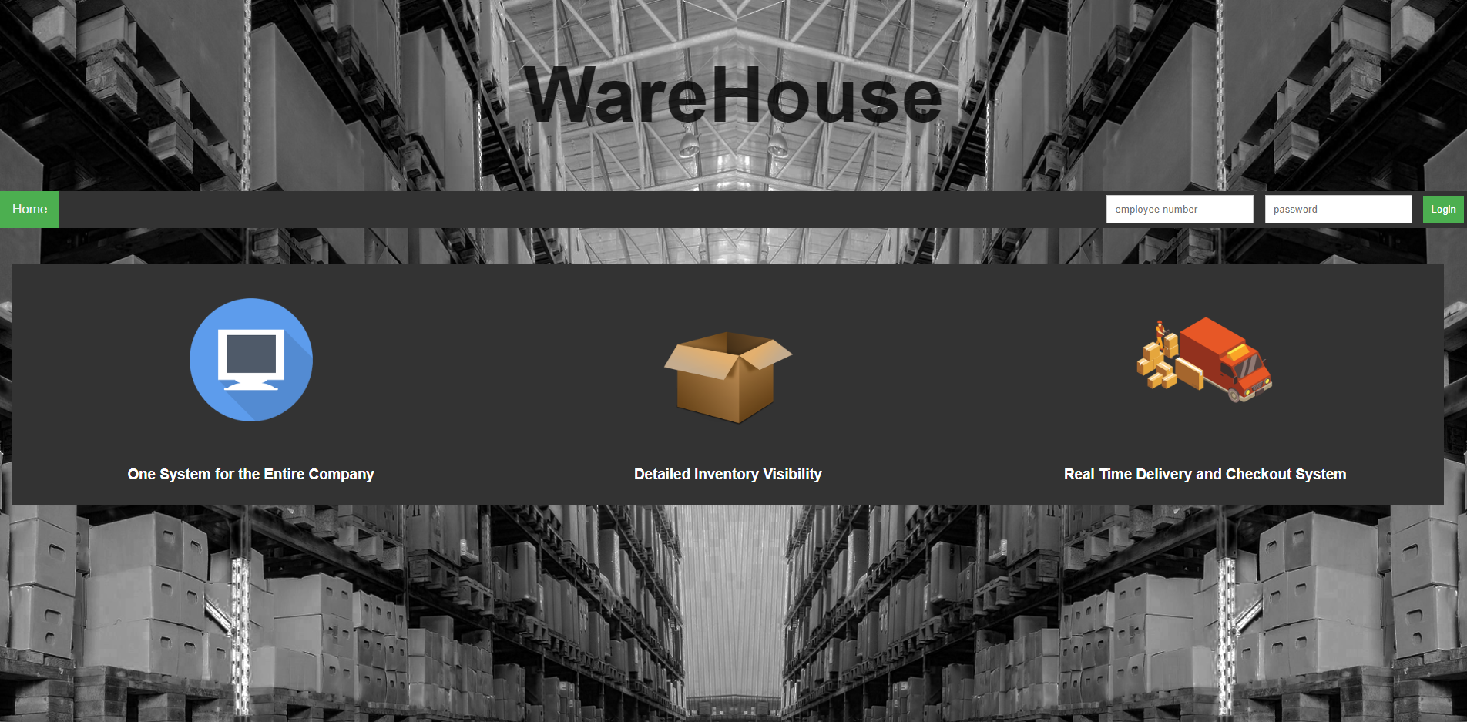
SNAPSHOTS

Slide 15
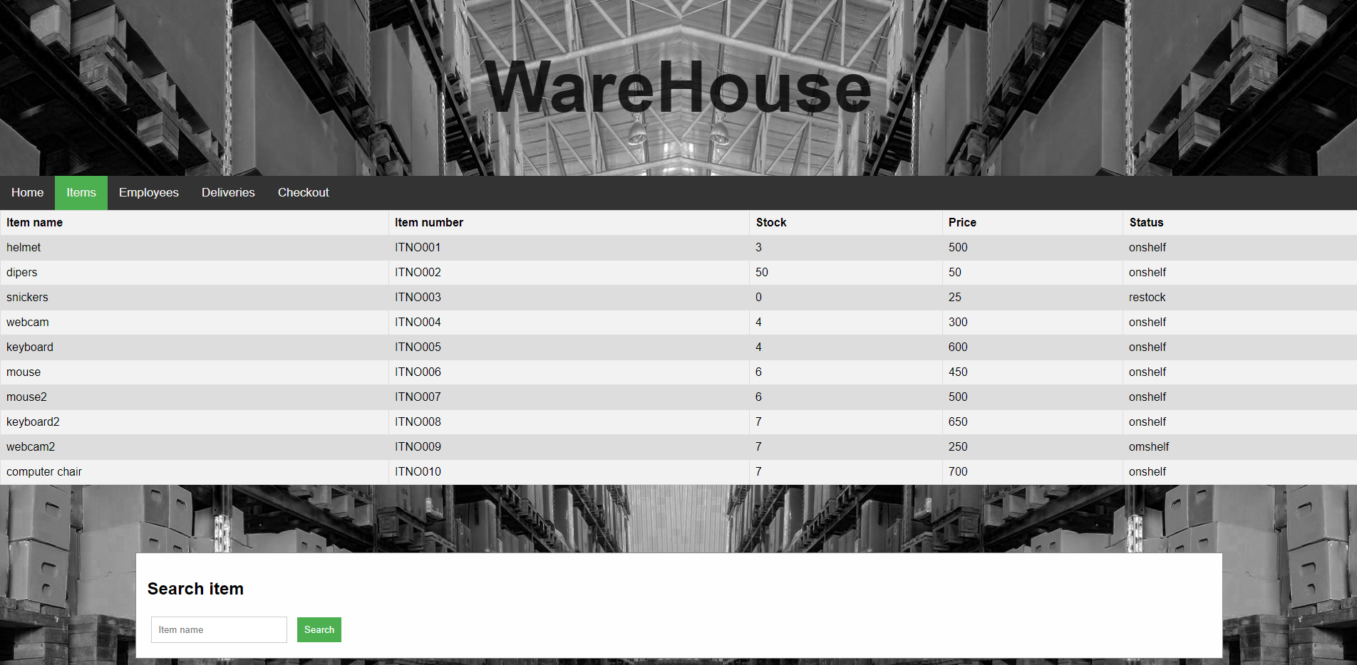

Slide 16
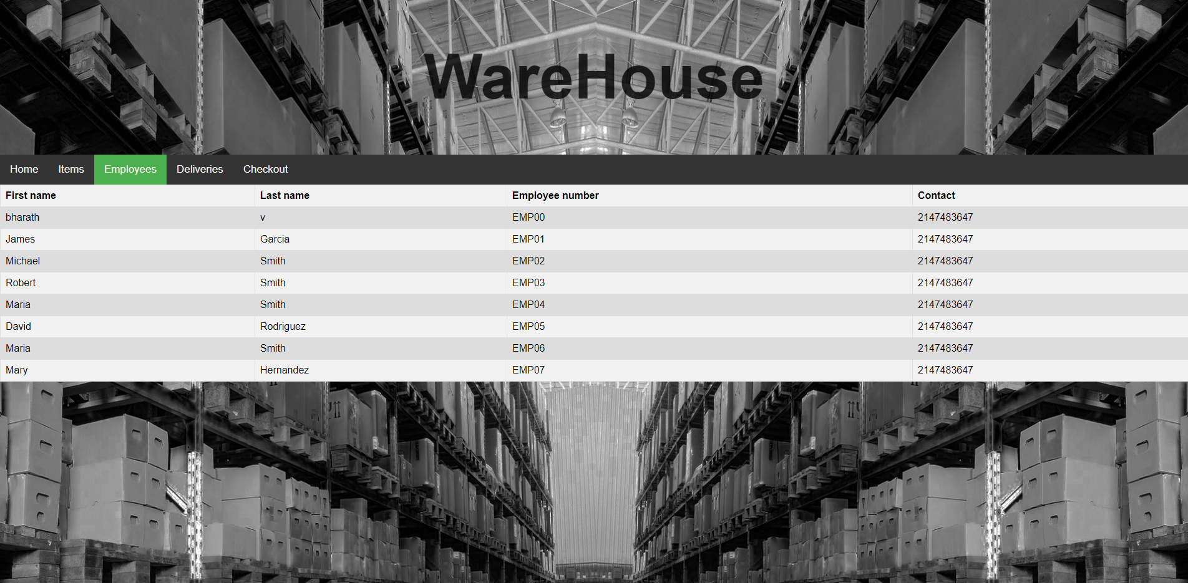

Slide 17
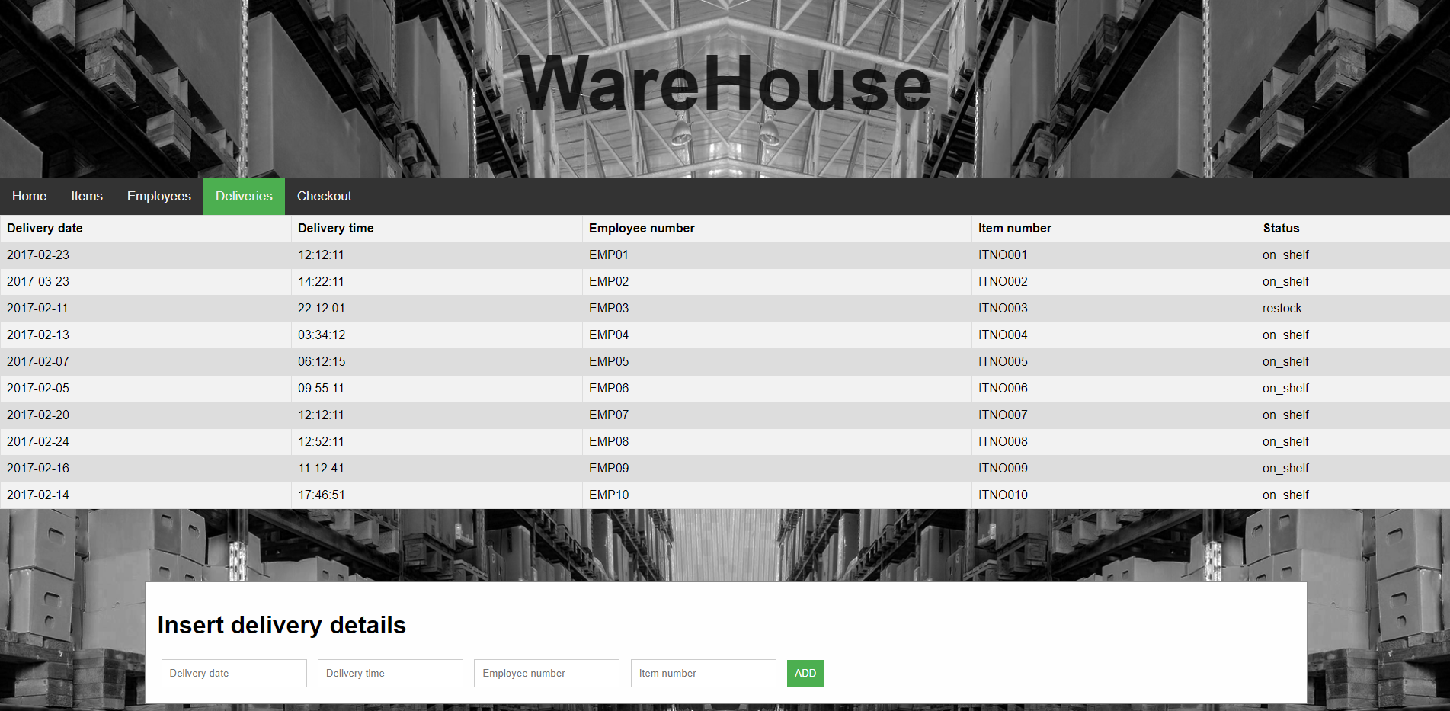

Slide 18
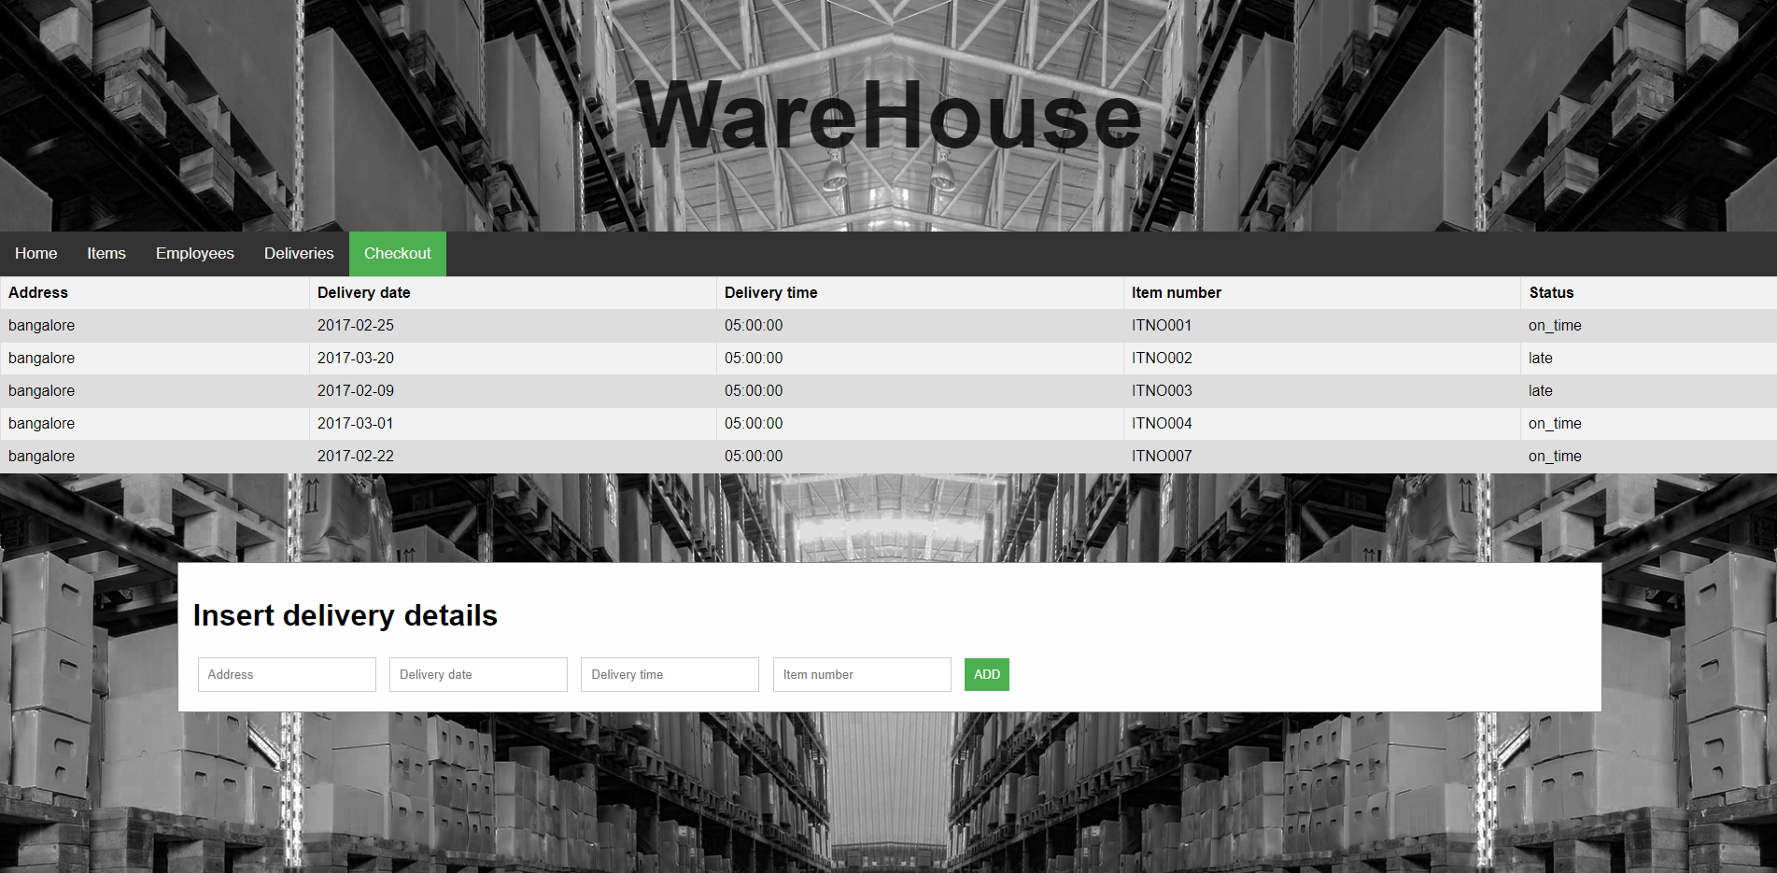

Slide 19
APPLICATIONS

Slide 20
CONCLUSION
From a proper analysis of positive points and constraints on the component, it can be concluded that the product is a highly efficient GUI based component. This component can be easily plugged into many other platforms. Generally, the employees of the warehouse have to face a lot of problems in management of the goods. All this information has to be managed manually. So, there is a need to develop a system which helps locate and store items faster while also keeping track of the inventory space and updating the information in real time.

Slide 21
REFERENCES
wikipedia.org
www.google.com
www.w3schools.com

